Slide 1
CHAT-BOT SYSTEM FOR COMPUTERS, ACCESSORIES & REPAIR CENTER RECOMMENDATION
TMP – 23 - 283
Notes:
HOW TO START >>> Give real world example when we try search for a device.
(Good Afternoon All, Let me initiate our presentation asking this particular Q….)
How many hours have you spent searching the internet, asking friends when you are willing to buy a new device? In particular a Laptop, PC accessories or even repair centers.
Personally, as IT enthusiastic this is interesting for us, yet sometimes a hassle. And most definitely, it’s a hassle for who aren’t doesn’t have a IT domain knowledge, isn’t?
THUS:
Hybrid of Chat bot & recommender system for devices, accessories & repair centers.

Slide 2
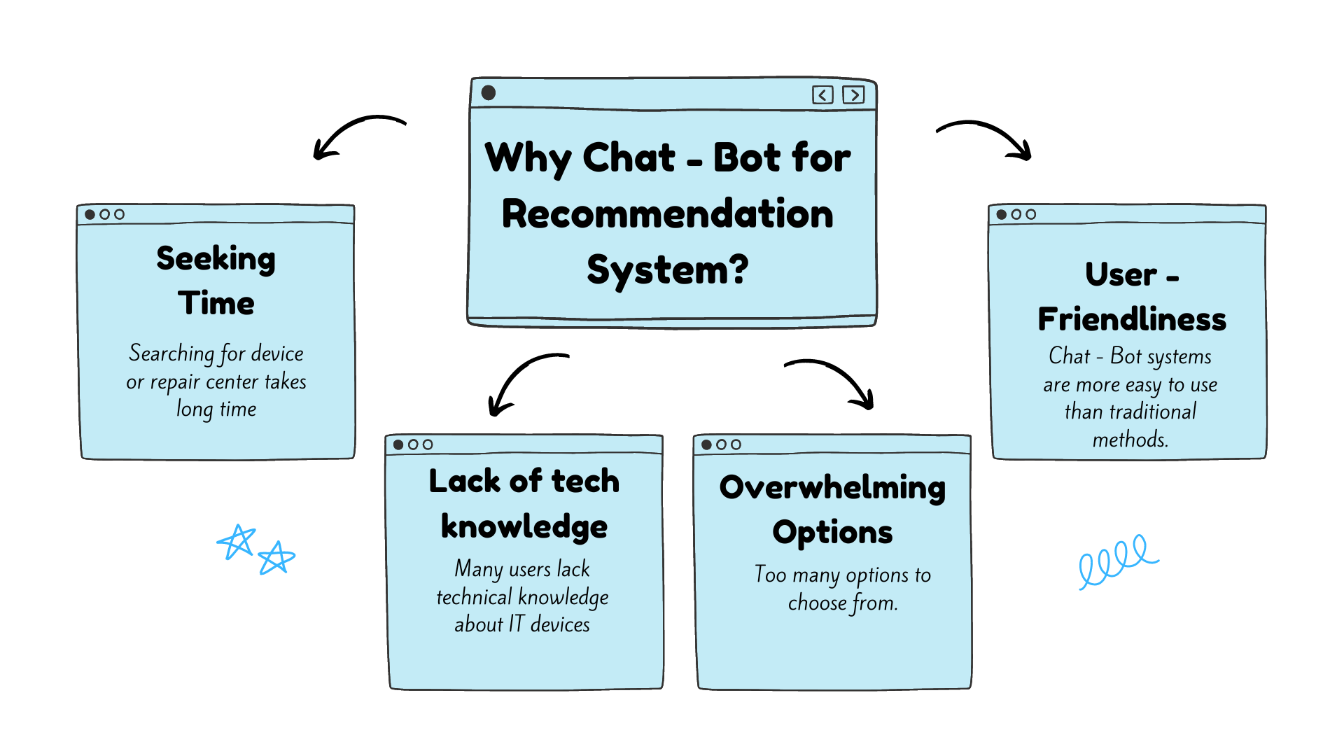
Research Problem
CHAT-BOT SYSTEM FOR COMPUTERS, ACCESSORIES & REPAIR CENTER RECOMMENDATION
Research Problem
Notes:
Identified problems in the real-world scenario: (Reason to implement such system)
Seeking time
Lack of knowledge
Too many options to choose from

Slide 3

Research Objectives
Increase user satisfaction and cater their needs.
Determined user needs by a Chat-Bot system using NLP and image processing techniques.
Recommender system to suggest devices & repair centers based on online reviews & product specification.
Web scraping and speech to text system from video reviews to gather data.
CHAT-BOT SYSTEM FOR COMPUTERS, ACCESSORIES & REPAIR CENTER RECOMMENDATION
Research Objective
Notes:
Increase User Satisfaction by introducing a Cha-Bot system.
Identify user needs via Chat-Bot system. (Inputs – Both Query & images)
Using Image processing to identify computer accessories & Query processing to identify keywords.

Slide 4
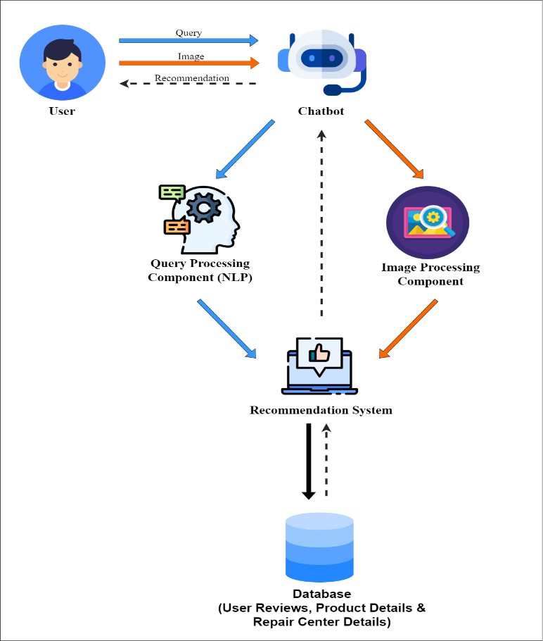
Overall System Diagram
CHAT-BOT SYSTEM FOR COMPUTERS, ACCESSORIES & REPAIR CENTER RECOMMENDATION
Overall Diagram
Notes:
High level architecture.
All 4 components of our system are included.
Chat Bot & NLP
Image processing Component
Recommender System
Web Scraping for data gathering & speech to text from video reviews.
My colleagues & I will dive into specifics in the individual components.

Slide 5
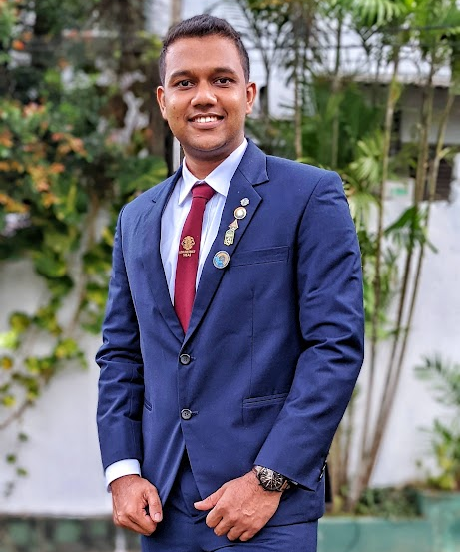
IT20225506 | Thirimanne S.U
B.Sc. (Hons) Degree in Information Technology Specialized in Data Science
IT20225506 | THIRIMANNE S.U | TMP – 23 – 283

Slide 6

Objective
Specific Objective: Objective of this component is to develop a Chat-Bot interface to identify user requirements and intent.
Identify specific keywords from the user query through NLP.
Sub Objectives:
Modify Chat-Bot system to input audio.
Modify Chat-Bot system in order to input images for image recognition system.
IT20225506 | THIRIMANNE S.U| TMP – 23 – 283

Slide 7
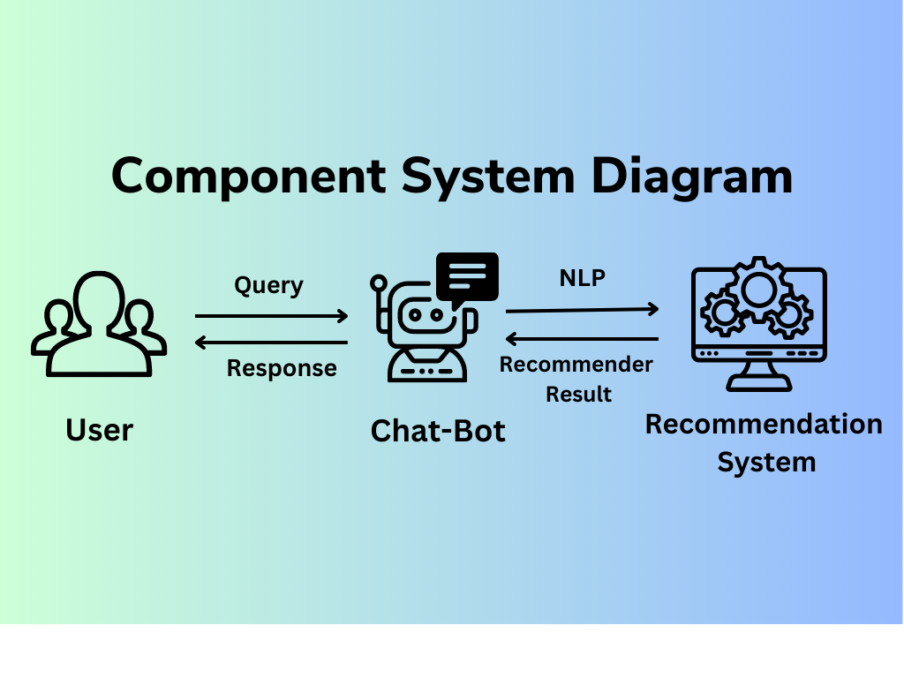
Methodology
State Based Chat Bot System
Technologies:
Flask, HTML, CSS, JavaScript
To Enhance and reduce latency :
Content Delivery Network (CDN)
Intent Classification Model
Name Entity Recognition Model
IT20225506 | THIRIMANNE S.U | TMP – 23 – 283

Slide 8

Methodology of how the models work
Message/Query
Intent Classification Model
State of Chat Bot
"Buy A Laptop"
"Find a repair Center"
NER Model
Capture Geolocation
Recommendation Model
Recommend Repair Center
Recommend Laptop
IT20225506 | THIRIMANNE S.U | TMP – 23 – 283

Slide 9
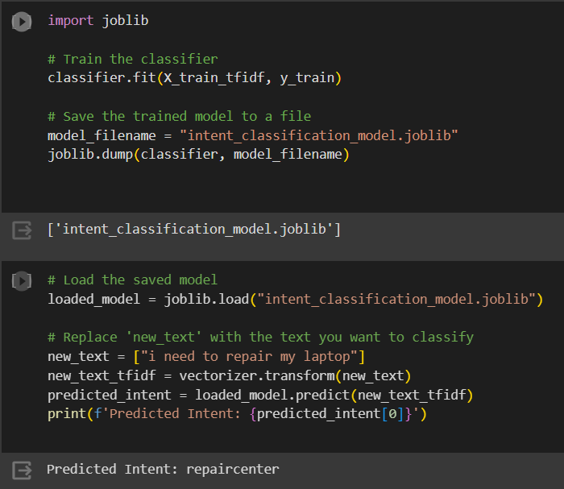

Intent Classification Model
Intent Classification Model
Intents: Greeting
Ending Buying Laptop Repair Center
A TfidfVectorizer is used to transform the text data into TF-IDF features.
A logistic regression classifier is used for training the intent classification model
Advantages:
Easy to change states of chat bot.
Easily start or end a chat.
IT20225506 | THIRIMANNE S.U | TMP – 23 – 283

Slide 10
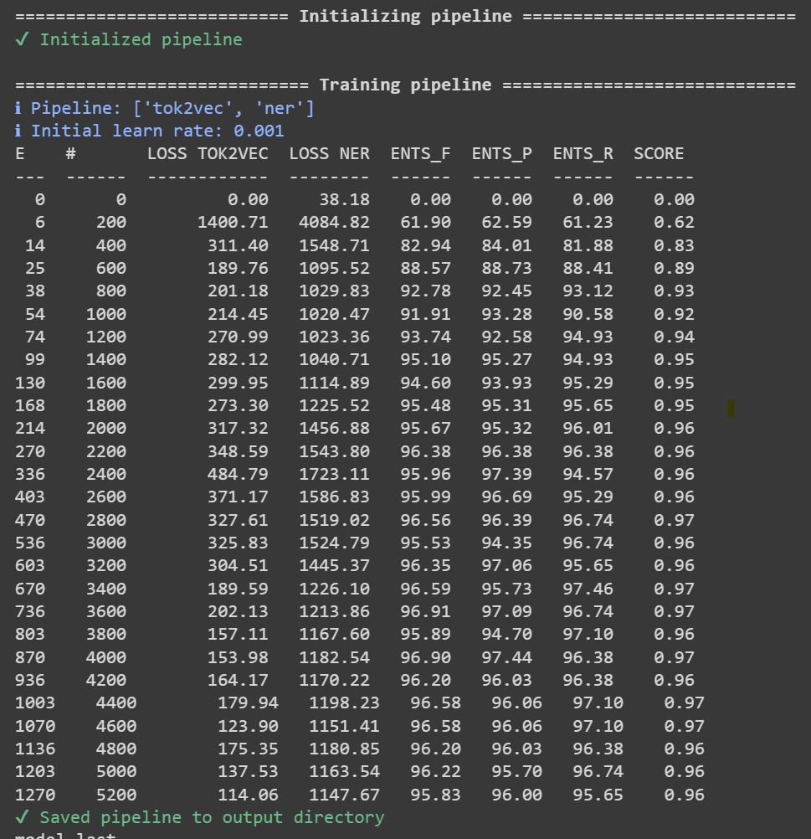
Name Entity Recognition (NER) Model
text = "I'm am a developer . I want to buy a laptop with RTX 3050, intel i7, 144hz refresh rate with 14-inch screen"
Entity: developer, Label: JOB
Entity: RTX 3050, Label: GRAPHICS
Entity: intel i7, Label: PROCESSOR
Entity: 144hz, Label: REFRESH RATE
Entity: 14-inch screen, Label: DISPLAY
Recommendation Model
IT20225506 | THIRIMANNE S.U | TMP – 23 – 283

Slide 11
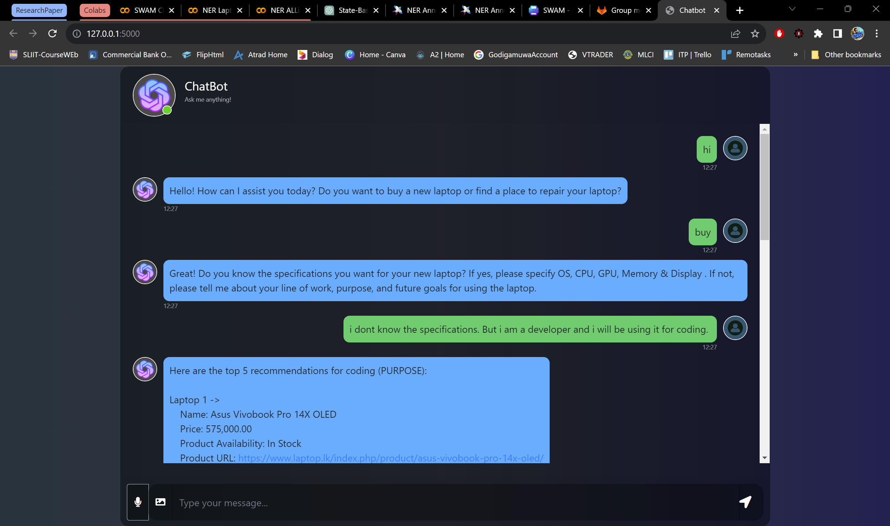
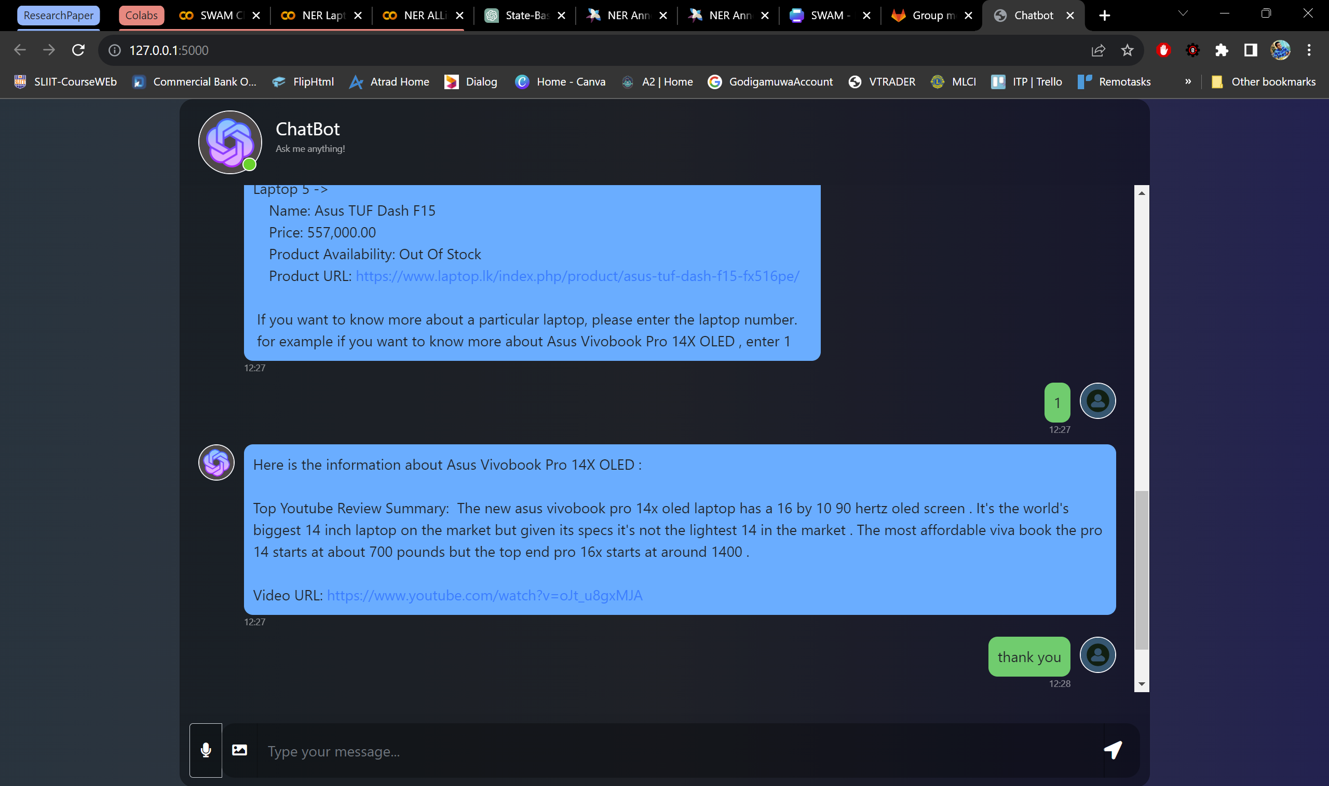
State Based Chat Bot System
Technologies:
Flask, HTML, CSS, JavaScript
To Enhance and reduce latency :
Content Delivery Network (CDN)
IT20225506 | THIRIMANNE S.U | TMP – 23 – 283

Slide 12
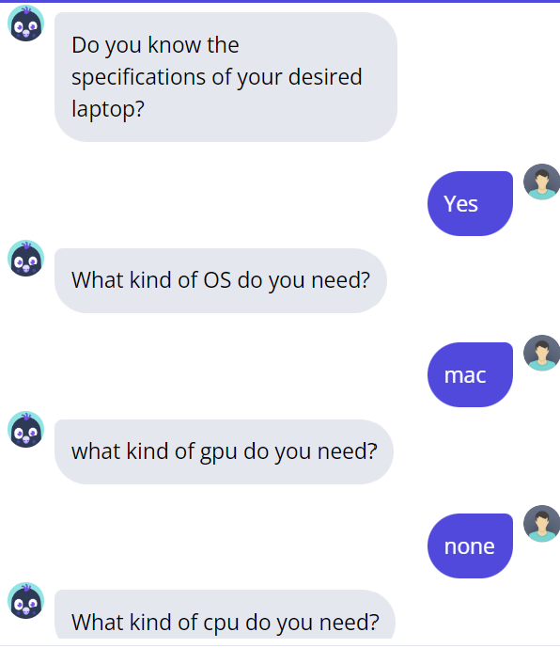
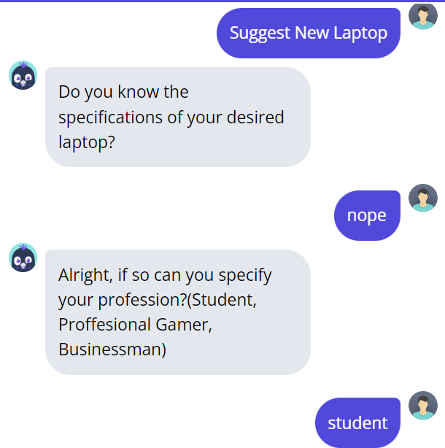
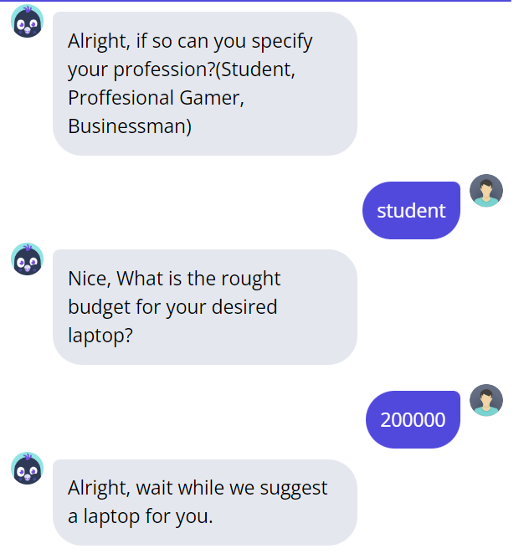
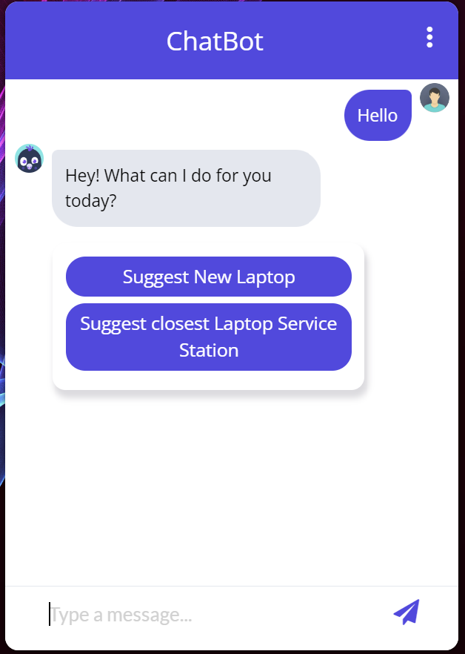
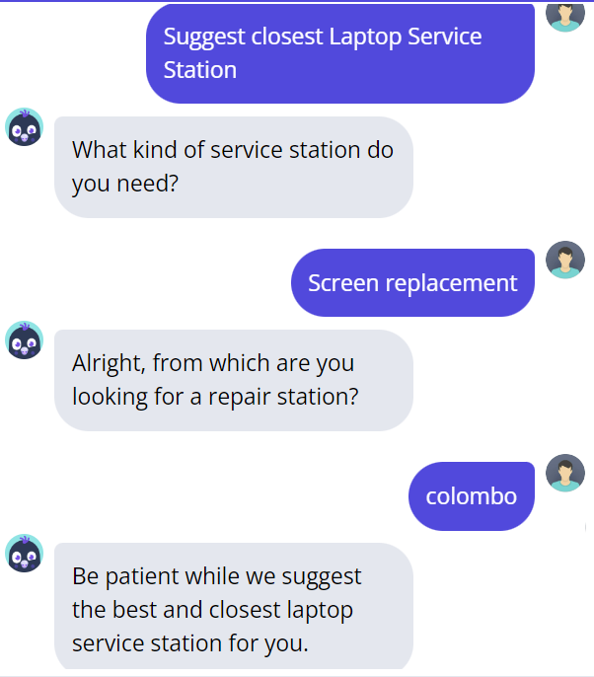
IT20225506 | THIRIMANNE S.U | TMP – 23 – 283

Slide 13
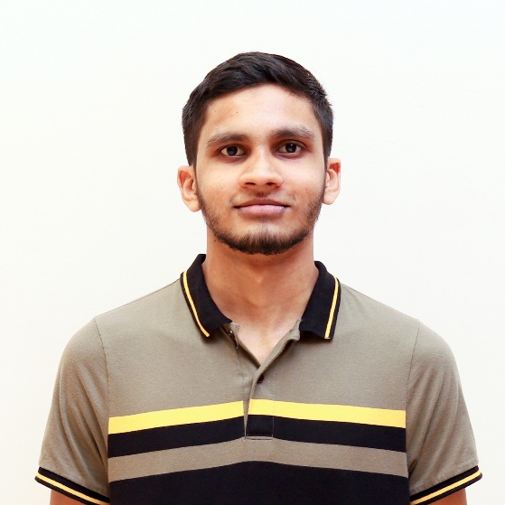
M.U. Amanullath | IT20155520
B.Sc. (Hons) Degree in Information Technology Specialized in Data Science
IT20155520 | M.U. Amanullath | TMP-23-283

Slide 14

Research Question
How to classify image of a computer hardware fast and accurately so that it can be used in a chat bot?
IT20155520 | M.U. Amanullath | TMP-23-283

Slide 15

Research Gap
While the existing work demonstrates how to implement object detection [1][2], it does not specifically address the identification of computer hardware components. There is a need for a specialized approach to accurately and efficiently identify computer hardware components in near real-time.
IT20155520 | M.U. Amanullath | TMP-23-283

Slide 16

Specific Objectives
The objective of this component is to develop a near-real-time computer hardware identification system that can accurately identify computer hardware components (mainly RAM and storage).
Integrate the classification algorithm into a chat bot interface for real-time identification and user interaction.
IT20155520 | M.U. Amanullath | TMP-23-283

Slide 17
Sub Objectives
Collect images of computer hardware components and label them using appropriate labeling tools.
Extract the high-level features of the images using a pre trained model.
Extract the most common keywords from the images using Optical Character Recognition (OCR)
Perform similarity checking when a new image is uploaded with our dataset and perform keyword analysis to extract extra information.
IT20155520 | M.U. Amanullath | TMP-23-283
Notes:
YOLO: YOLO stands for "You Only Look Once." It's an object detection algorithm that can quickly identify objects in an image and label them with a bounding box. It's called "You Only Look Once" because it only needs to analyze an image once to detect objects, unlike other algorithms that may need to analyze an image multiple times. This makes it a very fast and efficient algorithm for object detection.
Faster R-CNN: Faster R-CNN stands for "Faster Region-based Convolutional Neural Network." It's another object detection algorithm that uses a combination of a convolutional neural network (CNN) and region proposal network (RPN) to identify objects in an image. Essentially, it first generates potential regions in an image where objects may be located, and then uses the CNN to identify and label objects within those regions. It's a very accurate algorithm, but can be slower than YOLO.
Faster SqeezeNet: Faster SqeezeNet is similar to Faster R-CNN in that it also uses a CNN to identify objects in an image. However, it's different in that it uses a smaller and more efficient CNN architecture called SqeezeNet. This makes it faster than Faster R-CNN, but potentially less accurate.

Slide 18
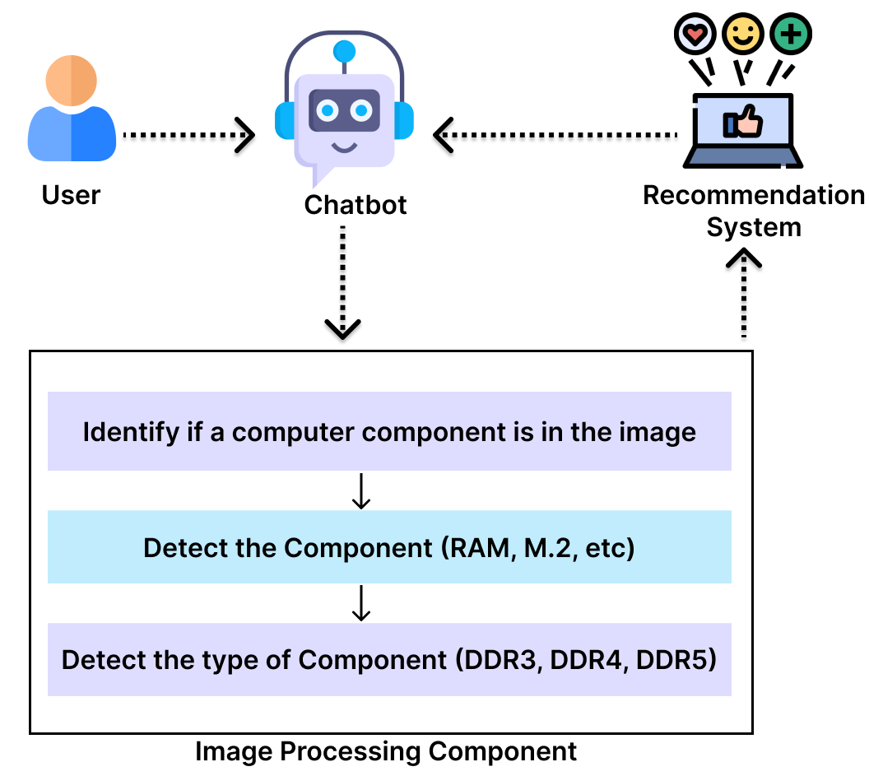
Methodology
IT20155520 | M.U. Amanullath | TMP-23-283

Slide 19
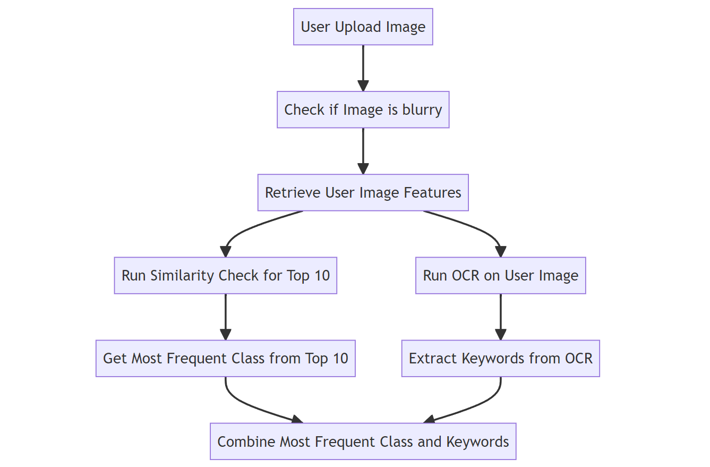
Methodology
IT20155520 | M.U. Amanullath | TMP-23-283

Slide 20
Results
For 255 images, 55 images per class
Custom CNN Model Accuracy - ~55%
Current Implementation Accuracy
Overall – 89.1%
Class wise -
GPU – 87.27%
HDD – 94.55%
CPU – 89.09%
RAM – 81.81%
SSD – 92.73%
IT20155520 | M.U. Amanullath | TMP-23-283

Slide 21
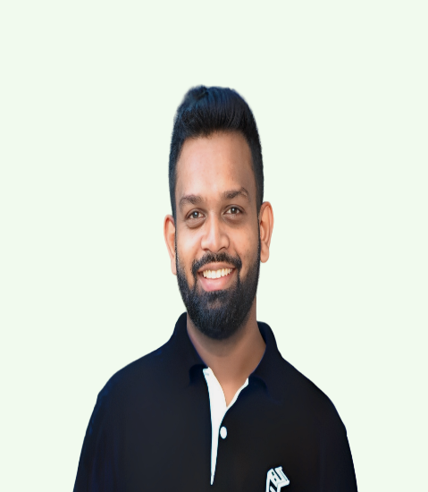
IT20237554 | Rathnaweera r.p.w.g
B.Sc. (Hons) Degree in Information Technology Specialized in Data Science
IT20237554 | Rathnaweera R.P.W.G| TMP-23-283

Slide 22
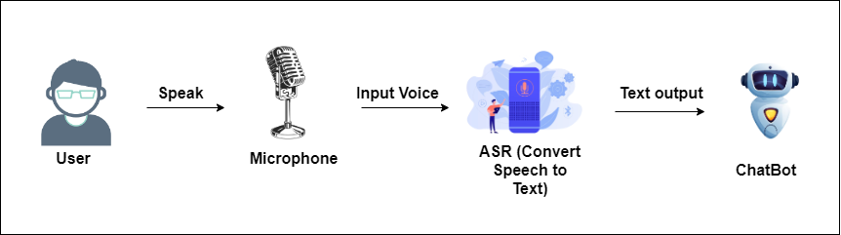
Specific and Sub Objectives
Main Objective
Development of an Automatic Speech Recognition system for feeding quires to Chatbot
IT20237554 | Rathnaweera R.P.W.G| TMP-23-283

Slide 23
Specific and Sub Objectives
Sub Objective
Dataset creation
Developed custom data scrappers to gather data for the recommendation system
Google Maps Scraping
Developed a Google Maps Scrapper to scrape the computer repair centers for recommendation
Reviews automation
Suggest the video link and a summary of a YouTube review regarding a recommended device to the user
IT20237554 | Rathnaweera R.P.W.G| TMP-23-283

Slide 24
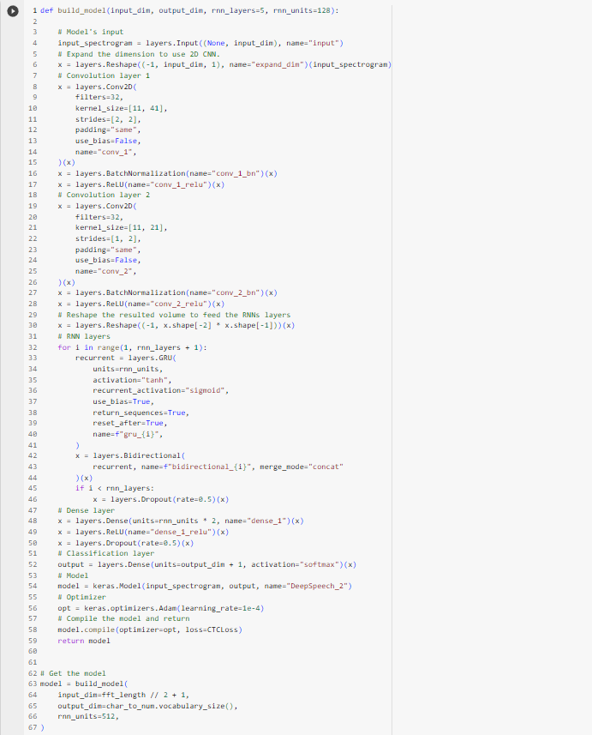
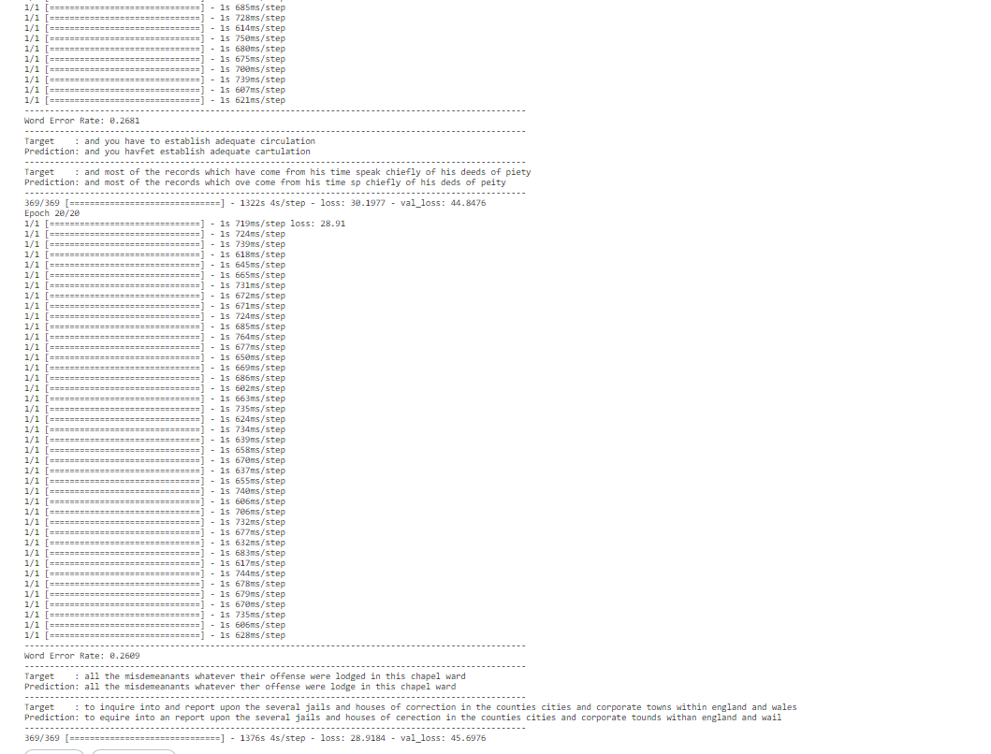
ASR – CTC Approach(Based on Deep Speech 2)
Connectionist temporal classification used where
It’s a model with RNN and CNN and trained on LJ speech dataset
Downsides of this model was it requires high computational power and less accurate even after running 20 epochs
IT20237554 | Rathnaweera R.P.W.G| TMP-23-283
Notes:
CTC –Connectionist Temporal Classification
Encoder only and a linear classification CTC on top of it as a head
Disadvantages – Spelling errors
Trains entirely on unlabeled data
Mostly popular ASR models like Wav2Vec2 ,HuBERT are based on CTC architecute

Slide 25
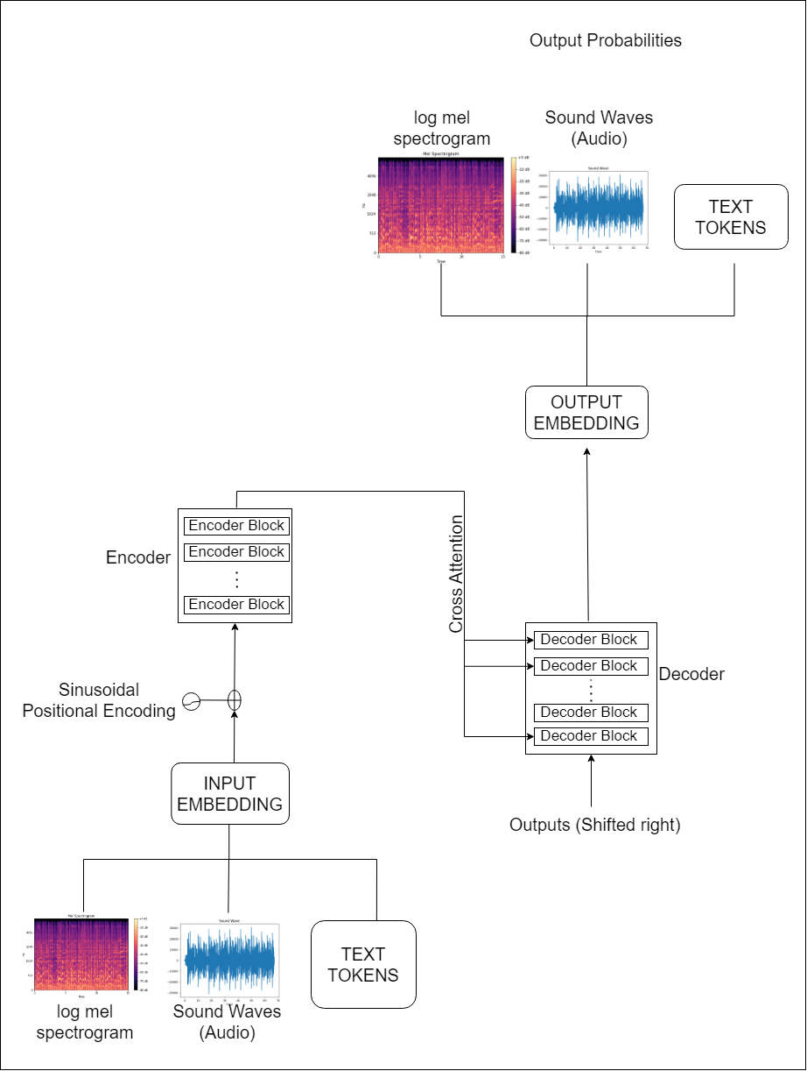
ASR – Seq2Seq Approach
Used Whisper model which was released in end of September 2022 where it has been trained for 680,000 hours of audio data and fined tuned this whisper model for my requirements with “Commen Accent” dataset.
IT20237554 | Rathnaweera R.P.W.G| TMP-23-283
Notes:
Sequence to Sequence model architecture which uses both encoder and decoder which is linked via cross attention mechanism.
Where Encoder computes hidden-state representations of audio inputs
And decoder plays the role as language model
Disadvantages – Slower Decoding –decoder steps happen one step at a time
More data hungry – requires significantly more training data to reach convergence
######################################
Dataset.
For this research purpose, we are going to target the Sri Lankan audience which means most of our English accent is a bit different when compared to the other countries' English accent, Sri Lanka India Bangladesh Pakistan are categorized into South Asian countries so that for in Sri Lankan basically we are using that speaking accent of English. So, we got a dataset named Common Accent which consists of South Asian voice clips.
Data preprocessing for the model.
Sampling rate – Measures the values of continuous signals of a fixed timestamp.
The number of samples taken in one second was measured in hertz.
Human speech is below 8000Hz so in this model, I had to resample the data into 16000Hz sampling rate is enough.
High sample rate – not capturing more information and high computational power.
A low sampling rate results in information loss which is why I got a mid-range of 16KHz.
We created spectrograms as model inputs where speech helps to identify the different vowel sounds as each vowel is characterized by frequencies.
The widely used spectrogram is Mel -the spectrogram for speech processing shows the frequency content of an audio signal over time but on a different frequency axis log-Mel-spectrogram.
Logmel spectrograms are used due to their capability of capturing more meaningful features of the audio signals from human perception.

Slide 26
Best Approach
CTC Approach | Seq2Seq Approach
High usage of computational power | Comparatively low usage of computational power
High rate of spelling errors | Low rate of Spelling errors
Only use Encoder | Use both decoder and encoder ( Can enhance the ASR for multiple languages)
Word Accuracy is Low | Word Accuracy is High
Difficult to handle High robustness, Noise inputs | High robustness, Noise inputs can be handled
Due to the above comparison, I had selected the seq2seq architecture model to fit for the chatbot
IT20237554 | Rathnaweera R.P.W.G| TMP-23-283

Slide 27
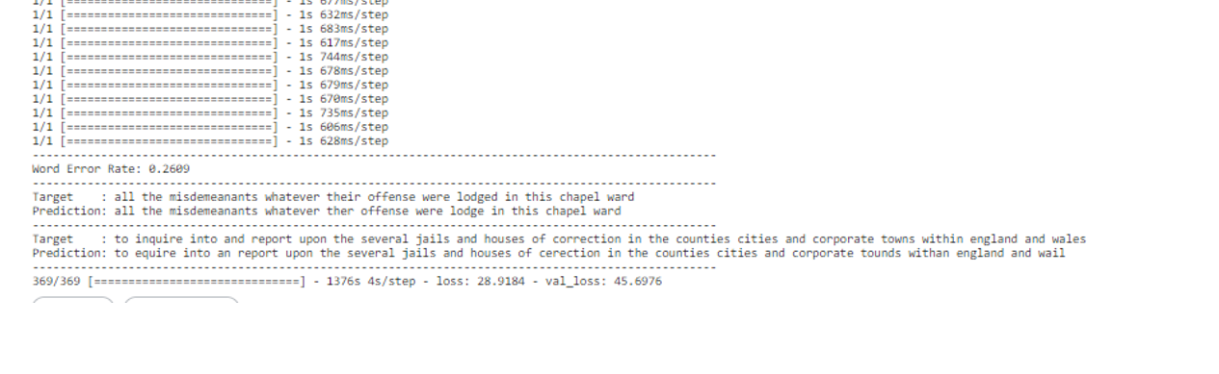
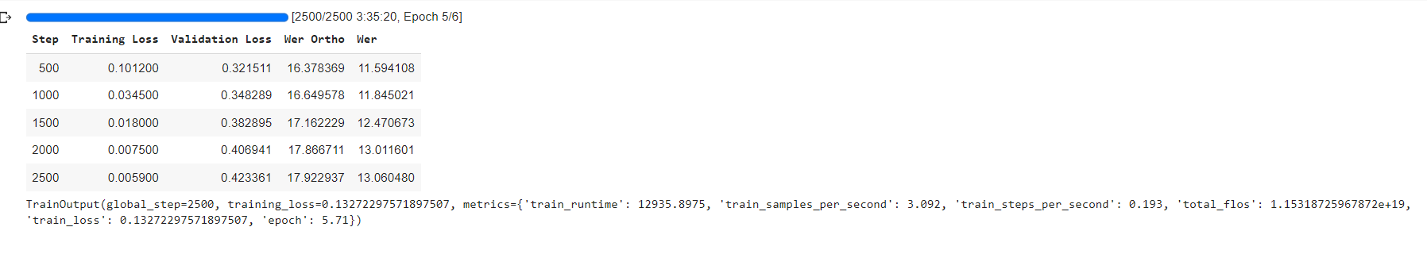
Model Results
CTC – Model based on Deep Speech2 | Seq2Seq Whisper finetuned model
WER = 0.26 (26%) WAcc = 1- 0.26 = 0.74 (74 %) | WER = 0.13 (13%) Wacc = 1 – 0.13 = 0.87 (87 %)
IT20237554 | Rathnaweera R.P.W.G| TMP-23-283

Slide 28
Seq2Seq - Model Testing
2 models were built for the Seq2Seq approach.
Model 1 Model with 500 steps up to 8 epochs | Model 2 Model with 2500 steps up to 6 epochs
Training loss - 0.0019 Epoch - 7.94 Step - 500 Validation Loss - 0.6059 WER Ortho - 22.9616 WER - 19.0970 | Training loss - 0.0059 Epoch – 5.71 Step - 2500 Validation Loss – 0.4234 WER Ortho - 17.9229 WER - 13.0605
IT20237554 | Rathnaweera R.P.W.G| TMP-23-283
Notes:
hyperparameters by changing the training steps (representing the individual parameter updates that occur within an epoch. For example, if you have 1,000 training examples and you're using mini-batch gradient descent with a batch size of 100, there would be 10 training steps (parameter updates) within each epoch (1,000 / 100 = 10)
As can be seen in model 2 after running up to 2000 steps (around 4.57 epochs) training loss is decreasing and the validation loss is increasing model is trying to overfit since it has been stopped with a smaller number of epochs.
wer ortho: "Wer Ortho" typically refers to orthographic transcriptions. Orthographic transcriptions are representations of spoken language in written form.

Slide 29
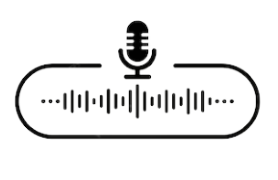
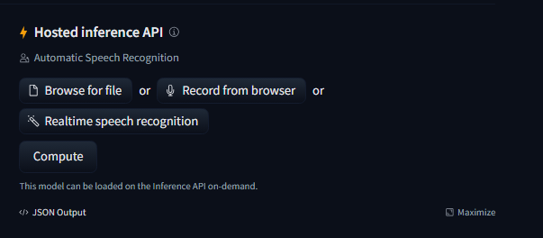
Seq2Seq - Model Testing
Created custom Audio clips to test the model.
Since both models were deployed in the Hugging Face API, tested those models by uploading the transcript for the API interface.
Audio | Transcript
 | I need a laptop to do my personal things and it should have a RTX 3060 VGA and 12GB RAM so I can do my stuff without any lag
IT20237554 | Rathnaweera R.P.W.G| TMP-23-283

Slide 30
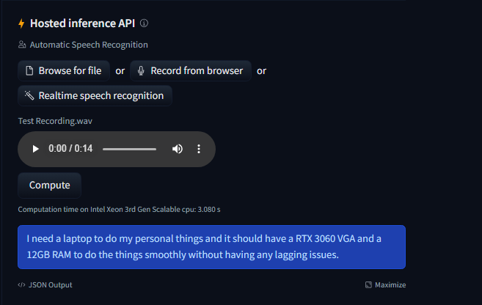
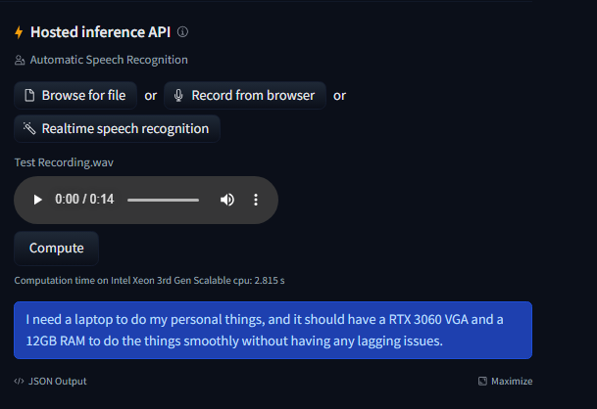
Seq2Seq Approach Model Results
When uploading an audio clip
Model 1 Results
Model 2 Results
IT20237554 | Rathnaweera R.P.W.G| TMP-23-283

Slide 31
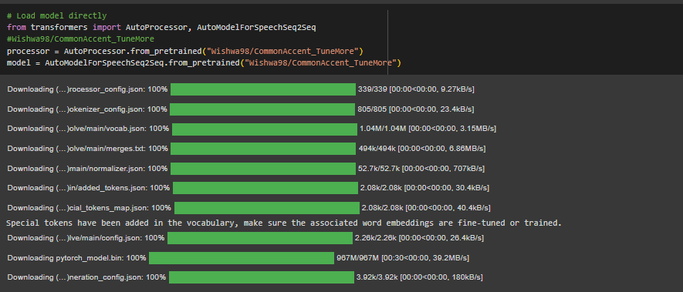
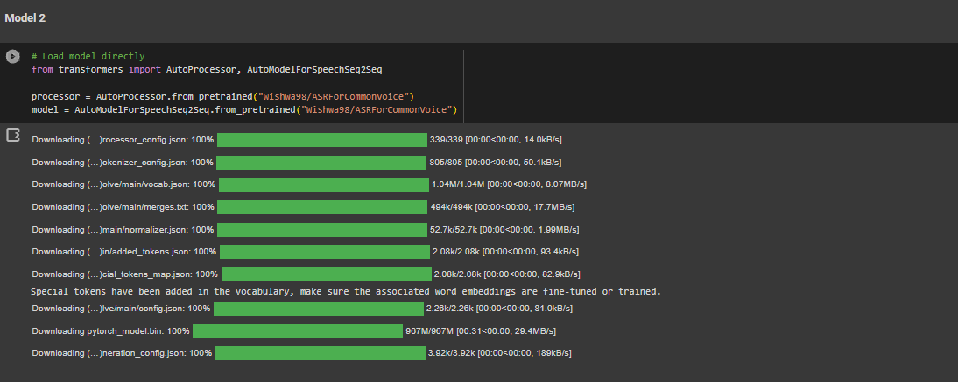
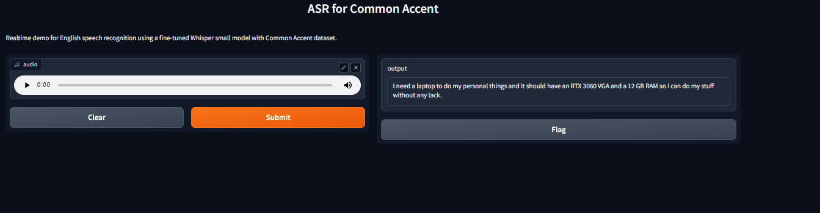
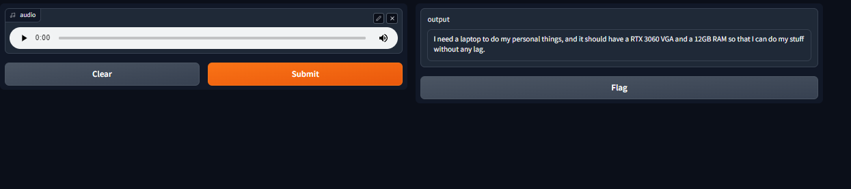
Seq2Seq Approach Model Results
For Real-time Voice recognition
Loading model 1
Model 1 Results
Loading model 2
Model 2 Results
IT20237554 | Rathnaweera R.P.W.G| TMP-23-283

Slide 32


Evaluation Metrices
$$WER=\frac{S+I+D}{N}$$
There are different word error categories as Substitution, Insertion Deletion in both word level and character level Here we used the Word level, which calculates the substitutions insertions, and deletions on a word level These errors are annotated on a word-by-word basis,
S=substitute
D=Delete
I=Insertion
N= Total number of words
Word Error Rate is an error matrix that can be convert into accuracy matrix
$$W_{Acc}=1−WER$$
IT20237554 | Rathnaweera R.P.W.G| TMP-23-283

Slide 33
Seq2Seq Approach Model Results
Expected Text – “ I need a laptop to do my personal things, and it should have a RTX 3060 VGA and a 12GB RAM so that I can do my stuff without any lag “
Can clearly see in the model 1 word “That” has been deleted and the word “lag” has been substituted with word “lack”
Due to the model evaluation results and the Realtime testing results , Selected the model 2 to implement In the chatbot interface.
Predicted Text (Model 1) | Predicted Text (Model 2)
“I need a laptop to do my personal things and it should have an RTX 3060 VGA and a 12GB RAM so I can do my stuff without any lack.” | “I need a laptop to do my personal things, and it should have an RTX 3060 VGA and a 12GB RAM so that I can do my stuff without any lag.”
IT20237554 | Rathnaweera R.P.W.G| TMP-23-283

Slide 34

IT20125998 | h.a.m sENADHEERA
BSc (Hons) in Information Technology specialized in
Data Science
IT20125998 | Minindu Senadheera | TMP-23-283

Slide 35

Background
Usually when someone want to buy an electronic device especially smart devices a techy person would at least do some research on the device for a week, this include
finding a device matches to him
Watch reviews on the device in YouTube, social media and other websites
Compare the specifications and prices with other similar devices and dealers
For a person with low technical background this is a challenging process, first thing he would do is get advice from one of his friend. Goal of our chat bot is to be that friend!
IT20125998 | Minindu Senadheera | TMP-23-283

Slide 36

Research Problem
How could a person with low technical knowledge find a laptop or computer repair center suits for his needs without the need of giving his technical requirements?
How well the system understand the user's requirement with or without the presence of technical data?
IT20125998 | Minindu Senadheera | TMP-23-283

Slide 37
Specific Objective & Sub objectives
Specific Objective
Main objective of this recommendation system is to recommend laptops to users as per their requirements with all the information they need at one place.
Recommend repair Centres in proximity with including google reviews.
Classification of users based on their query and computers based on their specs.
IT20125998 | Minindu Senadheera | TMP-23-283

Slide 38
Specific Objective & Sub objectives
Sub Objectives
Preprocess the dataset
Build a content-based recommendation model
Build a collaboration-based recommendation model
Inject parameters / features obtained from NLP & ASR models to recommendation model.
Provide the optimum results from both algorithms based on the user query
Train the collaborative based recommendation model on the go using user feedback
IT20125998 | Minindu Senadheera | TMP-23-283

Slide 39
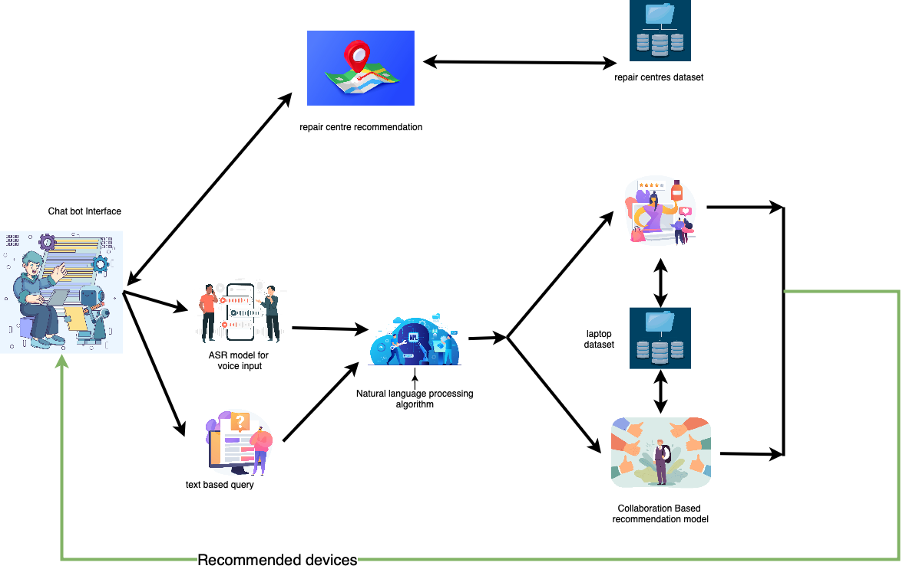
Component diagram
IT20125998 | Minindu Senadheera | TMP-23-283

Slide 40
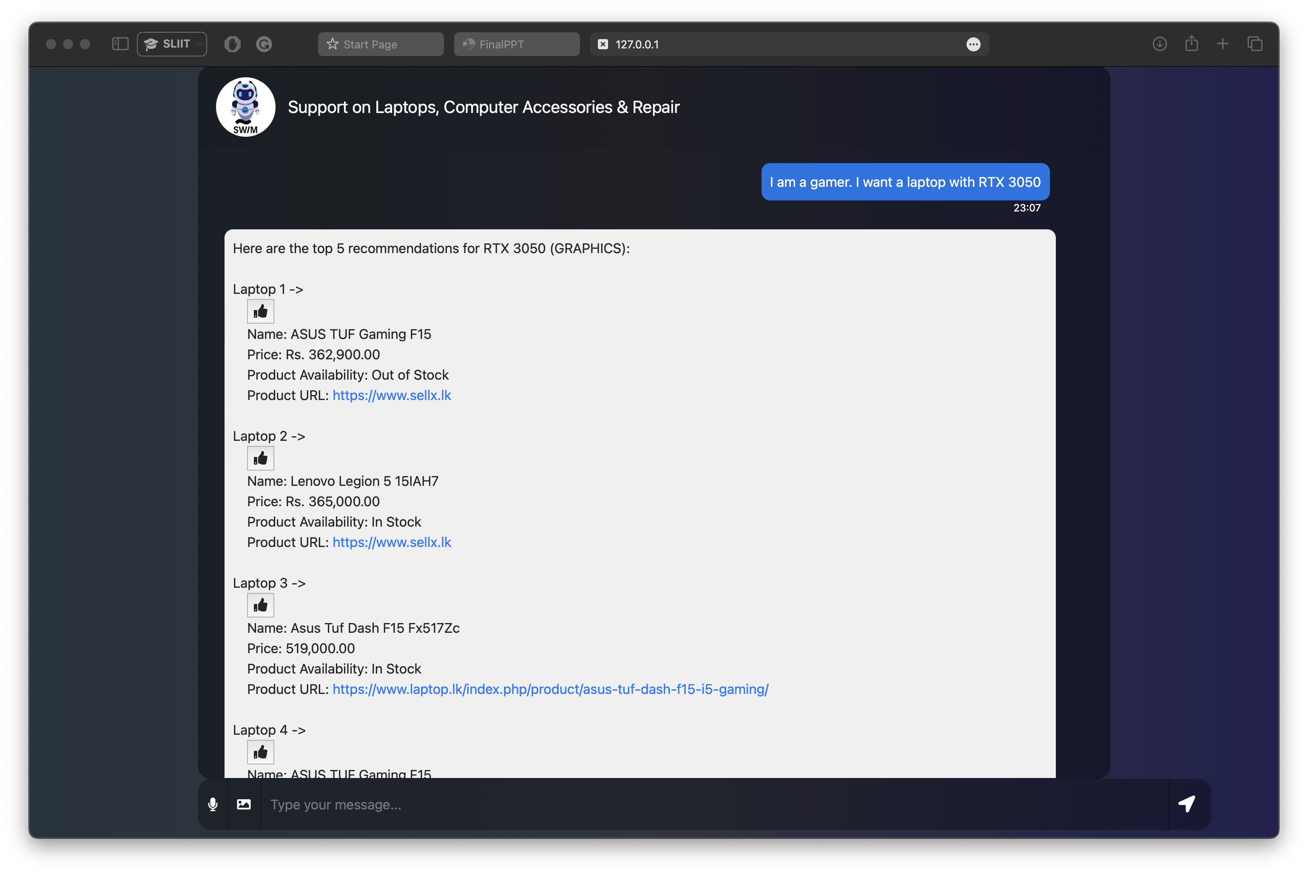
Content based recommendation
IT20125998 | Minindu Senadheera | TMP-23-283

Slide 41
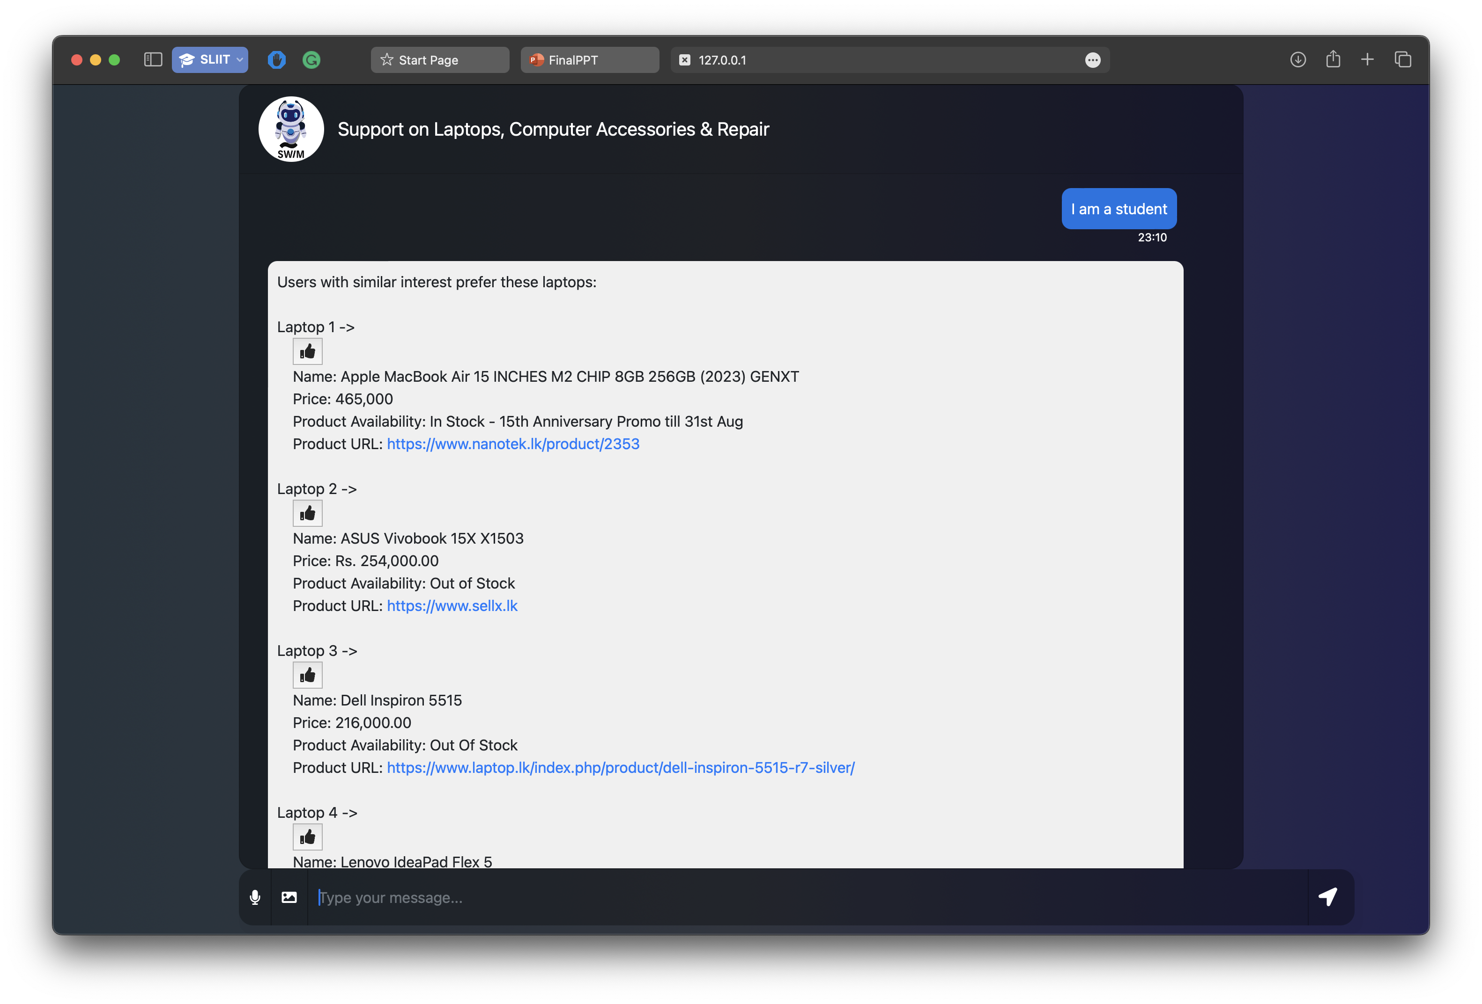
Collaborative based recommendation
IT20125998 | Minindu Senadheera | TMP-23-283

Slide 42
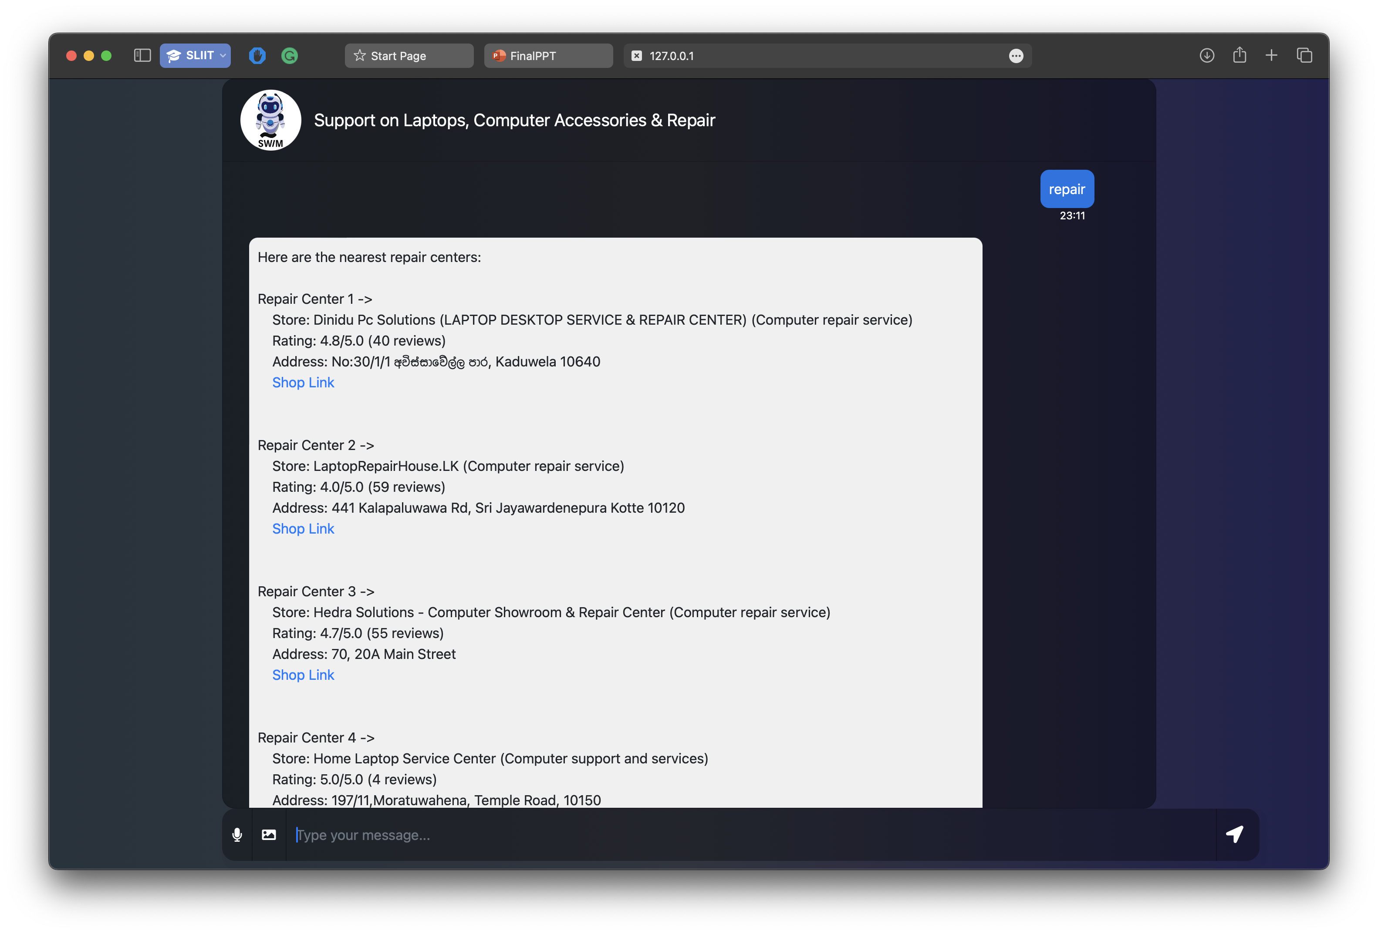
Repair recommendation
IT20125998 | Minindu Senadheera | TMP-23-283

Slide 43

Thank You!

